Slide 1

Real-Time Notification System
Using Spring Boot and WebSocket for instant, server-to-client communication
Presented By: T. Prem Charan | Register Number: 23AK1A3082

Slide 2

What Is a Real-Time Notification System?
A web application that delivers instant messages and alerts to users the moment an event occurs — with no page refresh required. The server pushes updates directly to connected clients, keeping users informed in real time.
💬 Chat Apps
Instant messages delivered without delay
🔔 Social Media
Live alerts for likes, comments, and mentions
🛒 E-Commerce
Order status and delivery updates in real time
🏦 Banking
Transaction alerts and security notifications

Slide 3
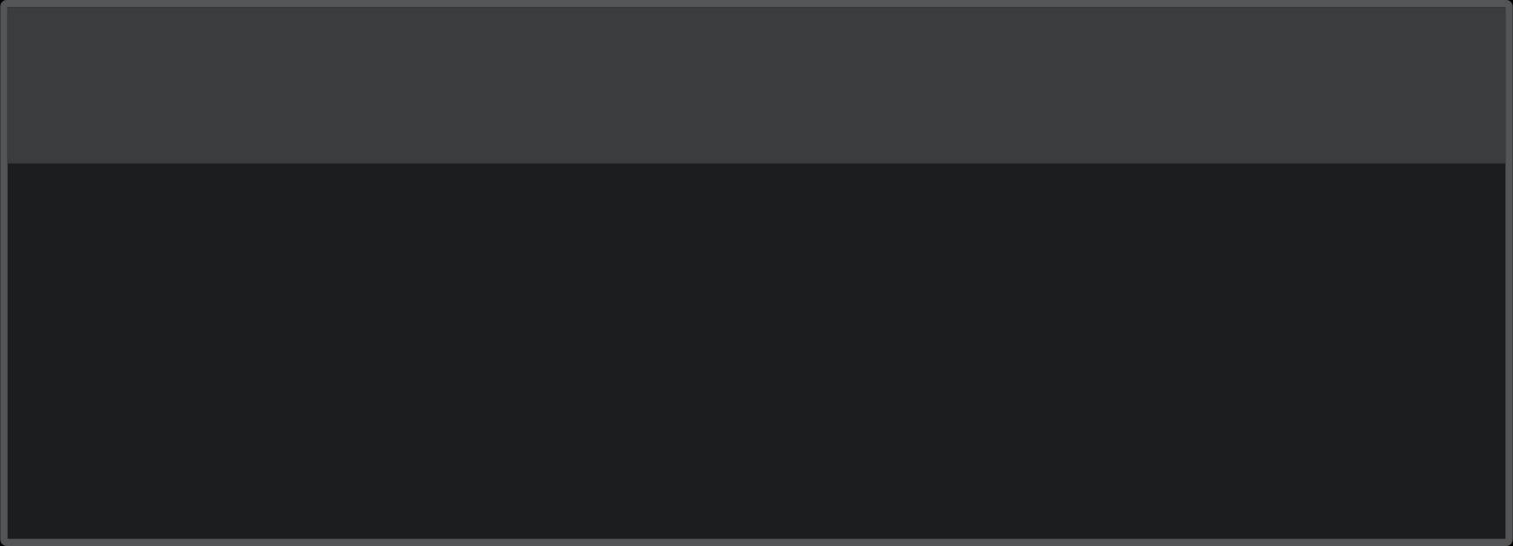
Project Objectives
This system is designed to bridge the gap between user actions and application responses, delivering a seamless and modern web experience.
1
2
Instant Delivery
Enhanced UX
Push notifications to users the moment an event is triggered
Improve responsiveness and reduce reliance on manual refresh
3
4
Multi-User Support
Efficient Communication
Handle multiple concurrent connections efficiently
Minimize server load through persistent WebSocket connections

Slide 4
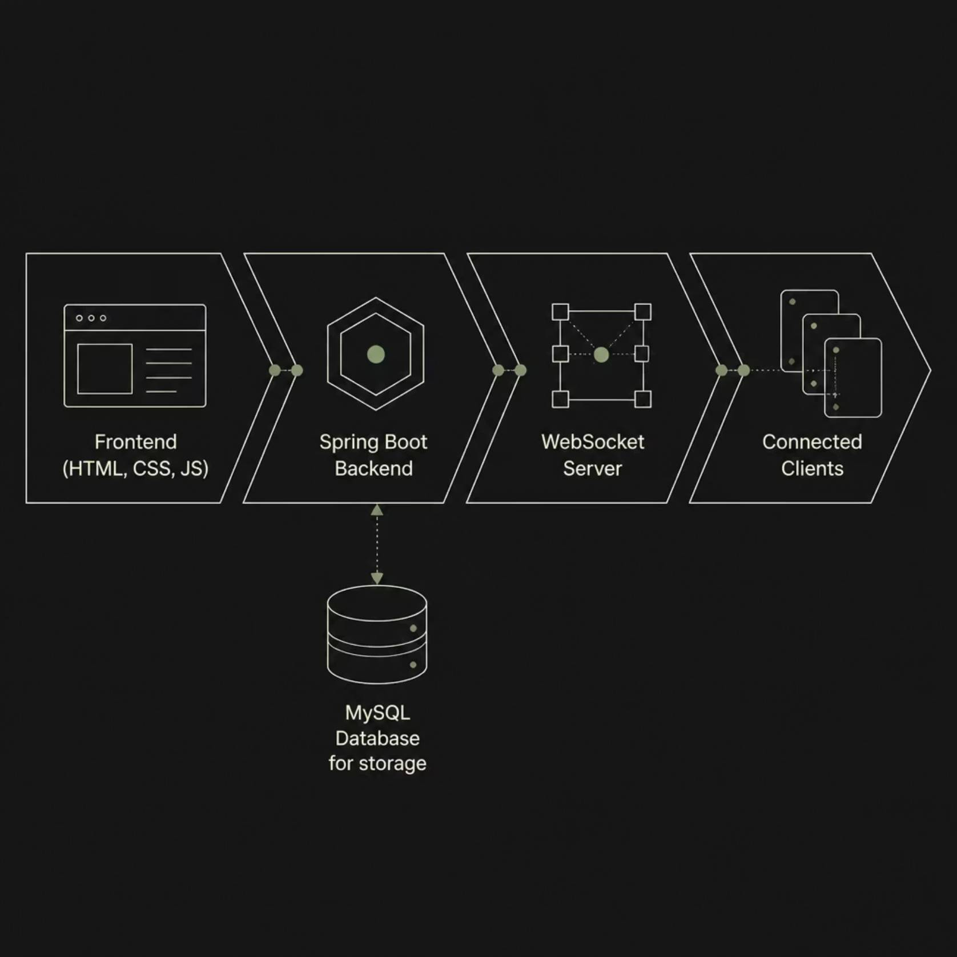

System Architecture
The architecture follows a clean layered approach. The Frontend captures user actions and displays notifications. The Spring Boot Backend processes requests and generates events. The WebSocket Server maintains persistent connections and pushes messages. The MySQL Database persists notification records.
WebSocket replaces the traditional request-response cycle with a persistent, full-duplex connection — enabling true server-to-client push.

Slide 5
Technologies Used
Each technology plays a specific role in delivering a robust, real-time notification experience.
Java
Core programming language for backend logic
Spring Boot
Rapid backend framework with embedded server support
WebSocket
Protocol enabling persistent, bidirectional communication
STOMP
Messaging protocol layered over WebSocket for structured payloads
MySQL
Relational database for persisting notification records
Maven
Dependency management and project build tool
HTML / CSS / JS
Frontend layer for user interaction and notification display

Slide 6
Project Structure
The project follows a standard Spring Boot layered architecture, separating concerns across controller, service, model, repository, and configuration packages for clean, maintainable code.
src/main/java/com/notification
├── controller/
│ └── NotificationController.java
├── service/
│ └── NotificationService.java
├── model/
│ └── Notification.java
├── repository/
│ └── NotificationRepository.java
├── config/
│ └── WebSocketConfig.java
└── RealTimeNotificationApplication.java

Slide 7
How It Works
User Action
1
User triggers an event on the frontend
Server Receives Request
2
Spring Boot processes the incoming request
Notification Generated
3
Server creates and persists the notification event
WebSocket Broadcasts
4
Message is pushed through the WebSocket channel
Clients Receive
5
All connected clients get the message instantly
Notification Displayed
6
Alert appears on the user's screen without refresh

Slide 8
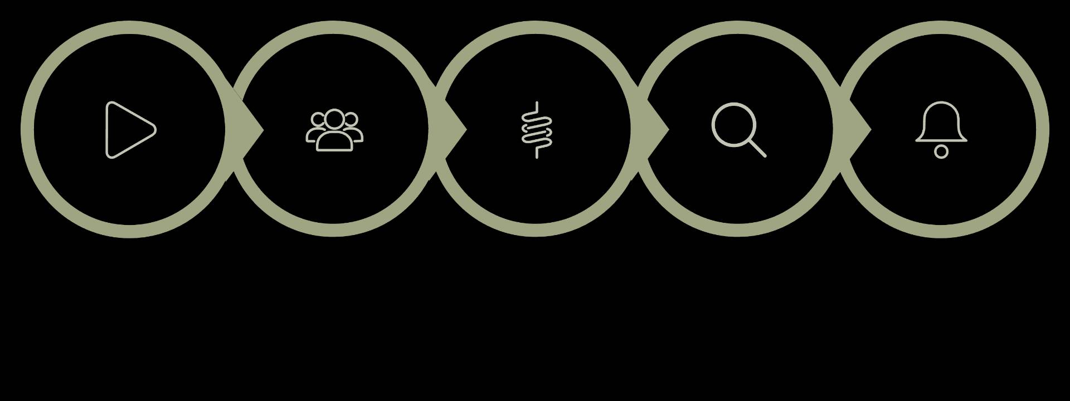
End-to-End Flow
WebSocket Broadcast
Start
User Action
Spring Boot
Clients Notify
The flow is entirely event-driven. Once a user action reaches the Spring Boot server, the notification lifecycle is automatic — from generation to delivery — with zero polling required from the client side.

Slide 9


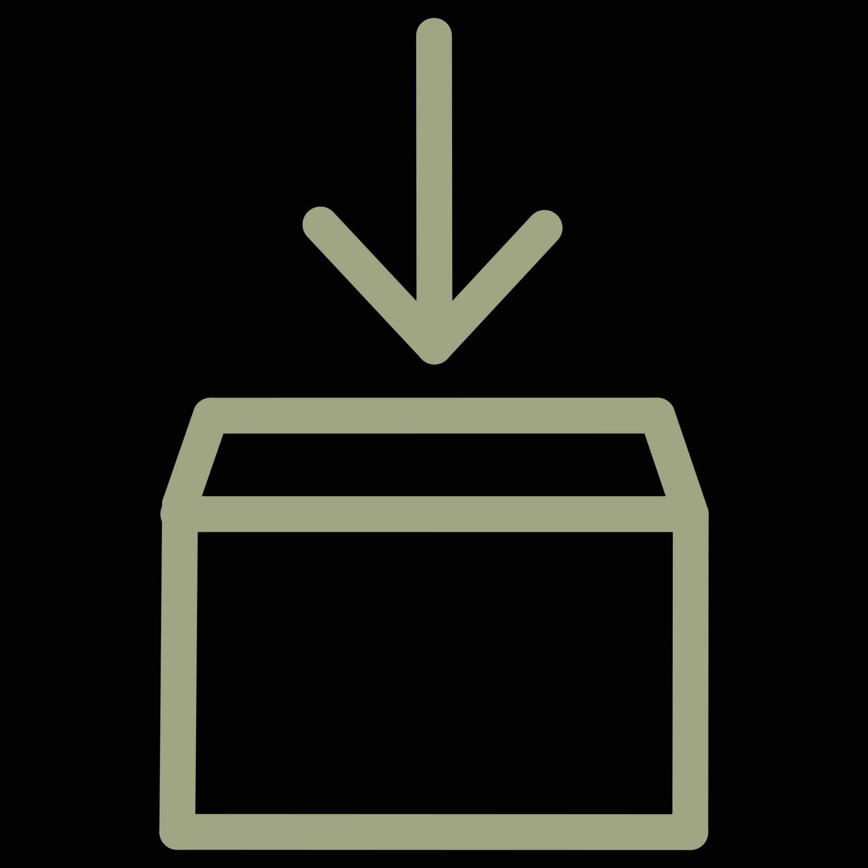

Key Advantages
Real-Time Updates
Improved UX
Notifications arrive instantly, eliminating latency and manual refresh cycles
Seamless, responsive interface keeps users engaged and informed
Reduced Server Load
Scalable & Reliable
Persistent WebSocket connections replace inefficient HTTP polling
Supports multiple concurrent users with consistent, reliable delivery

Slide 10

Conclusion
The Real-Time Notification System built with Spring Boot and WebSocket delivers a modern, scalable solution for instant server-to-client communication. It enhances responsiveness, drives user engagement, and eliminates the inefficiencies of traditional polling-based architectures.
Presented By
Register Number
T. Prem Charan
23AK1A3082
Thank You
Questions & Answers

